Slide 1
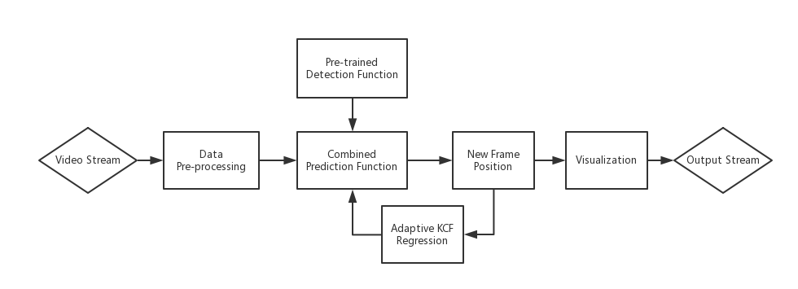
Pipeline

Slide 2
Demo

Slide 3
Next step
Change input method
Analyze the result quantitatively
Add face recognition

